Slide 1
Week 9: Template Matching
(I’m Fun) Digital Image Fundamentals
Thuong Nguyen Canh
Institute for Datability Science, Osaka University
November 2019
This material is based on the Digital Image Processing, Stanford University, Prof. Bernd Girod.

Slide 2
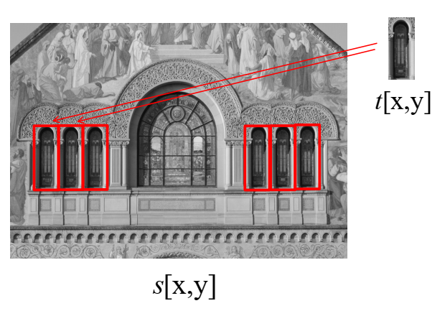
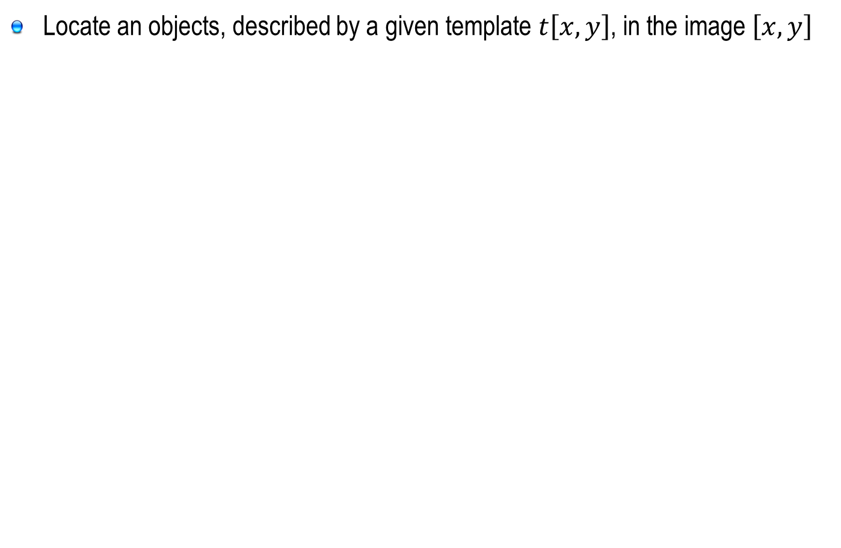
Contents
Locate an objects, described by a given template $t\left[x,y\right]$, in the image $\left[x,y\right]$

Slide 3
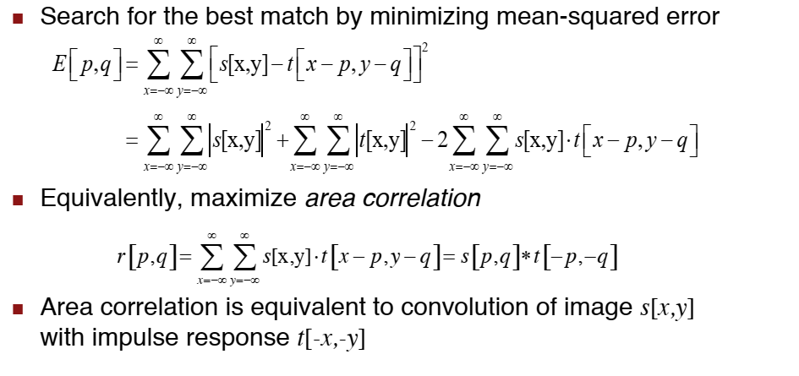
Template Matching
https://vi.wikipedia.org/wiki/%C4%90%C3%A1p_%E1%BB%A9ng_xung
Notes:
Morphological image processing is a collection of non-linear operations related to the shape or morphology of features in an image.

Slide 4
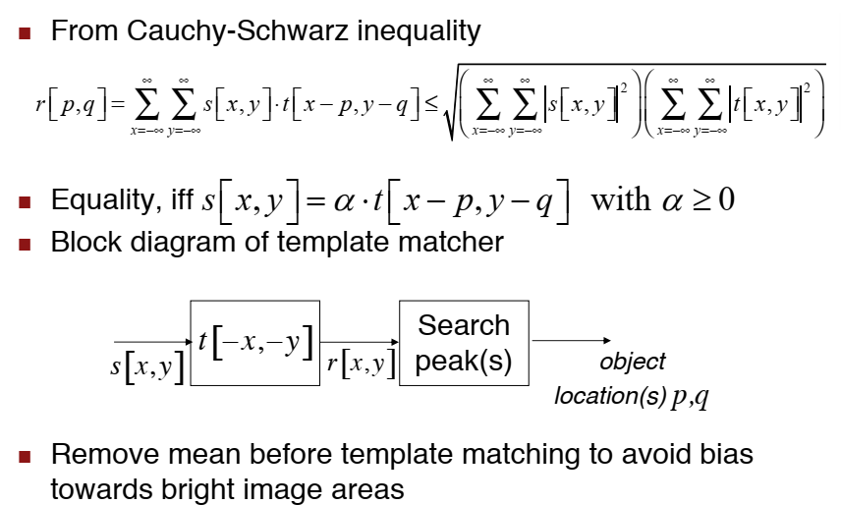
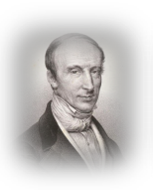
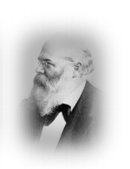
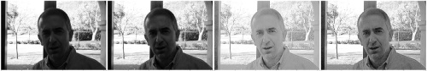
Template Matching
Brightness can change due to the auto focus/adjustment of the camera

Slide 5
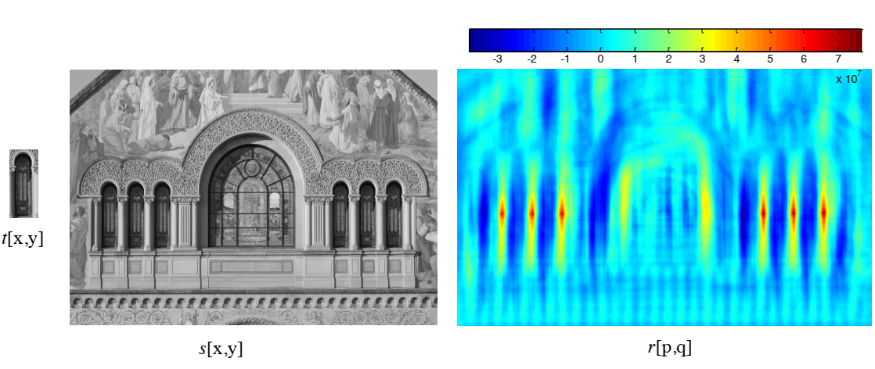
Example

Slide 6
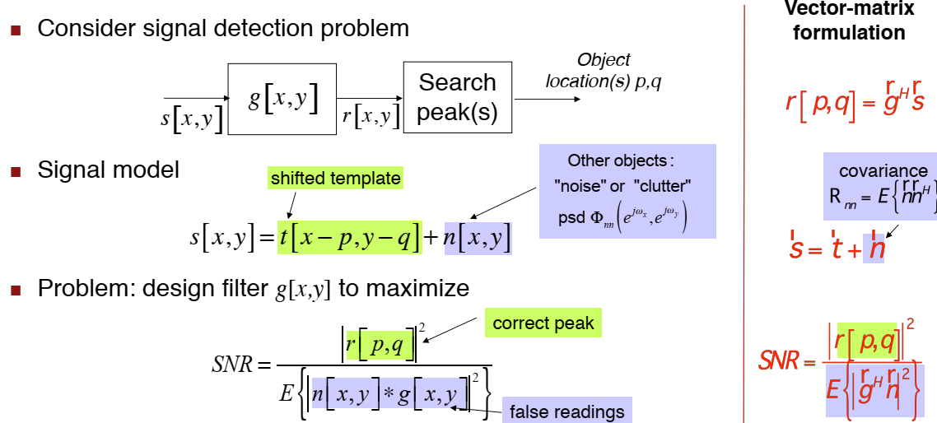
Matched Filtering
Matched Filtering: correlate a known delayed signal, or template, with an unknown signal to detect the presence of the template in the unknown signal
Maximize the SNR ratio
https://en.wikipedia.org/wiki/Matched_filter

Slide 7
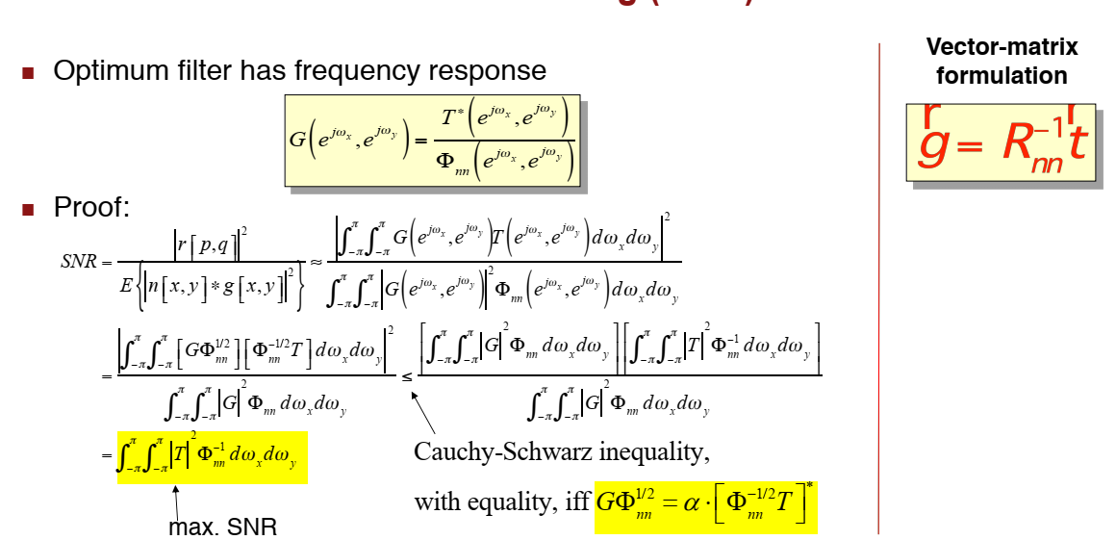
Matched Filter

Slide 8
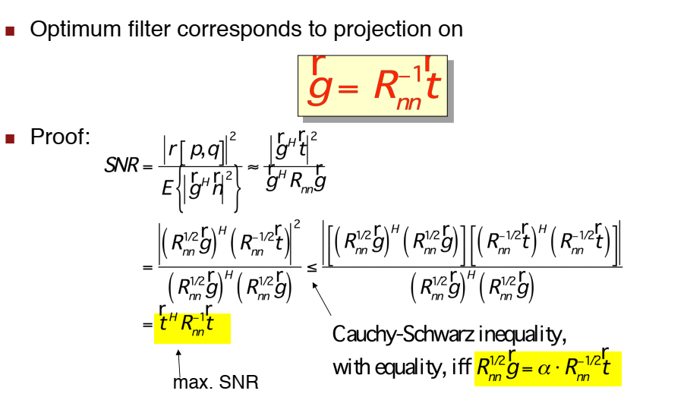
Matched Filter
The matched filter is the optimal linear filter for maximizing the signal-to-noise ratio (SNR) in the presence of additive stochastic noise
https://en.wikipedia.org/wiki/Matched_filter

Slide 9
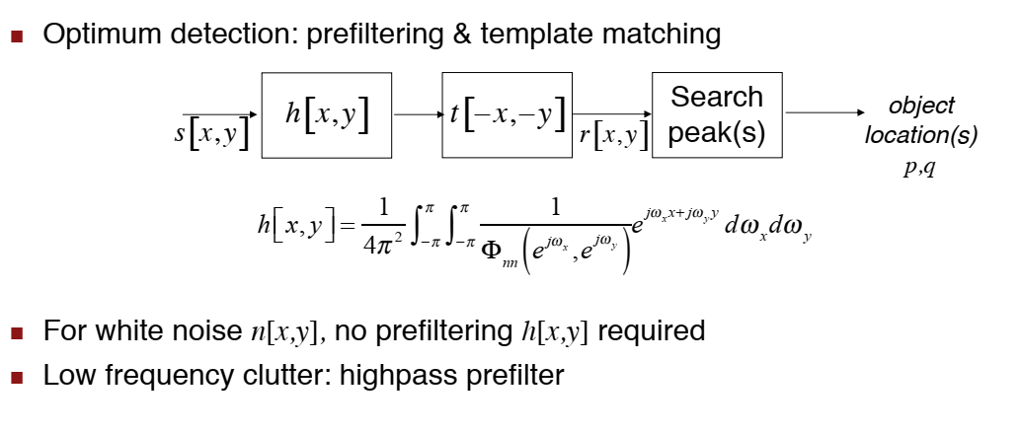
Matched Filter

Slide 10
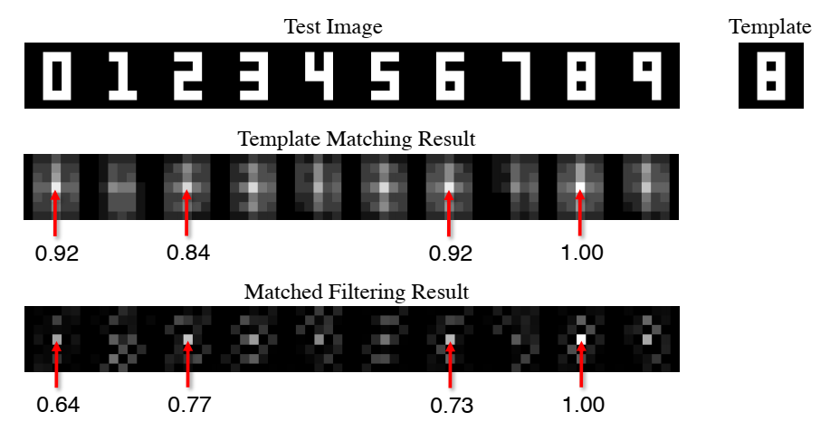
Matched Filtering Example

Slide 11
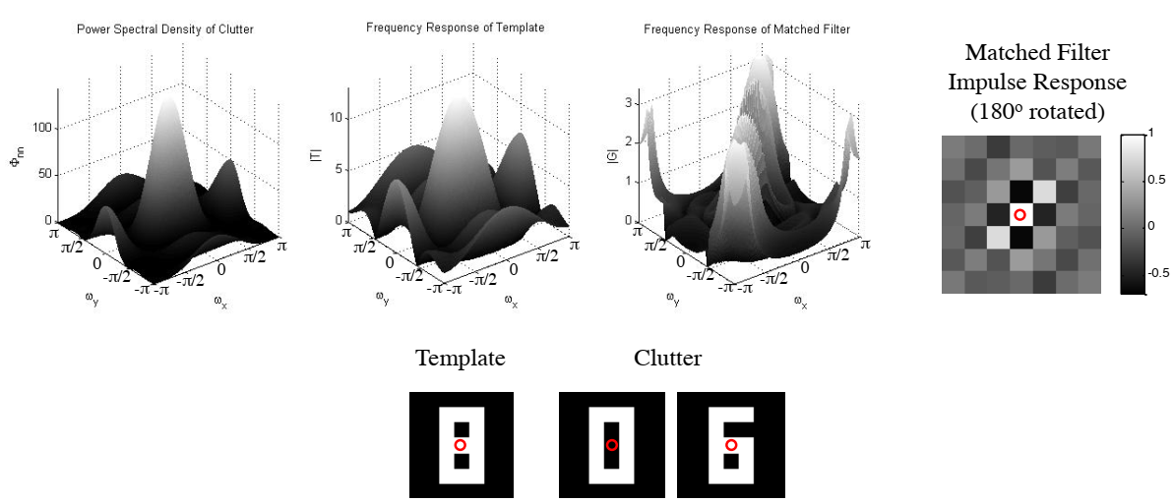
Matched Filtering

Slide 12
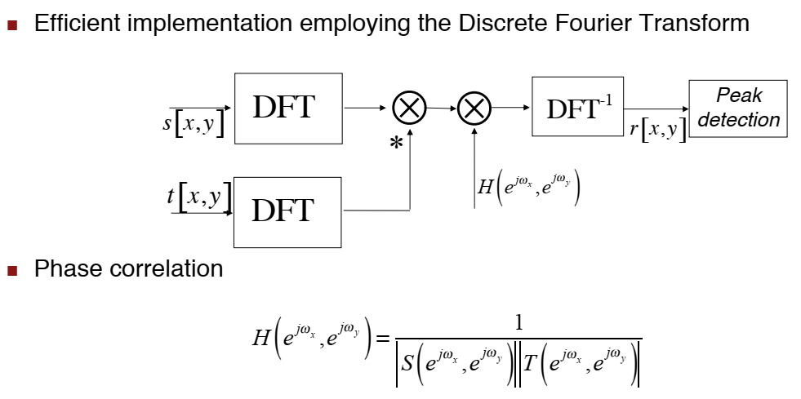
Phase Correlation

Slide 13
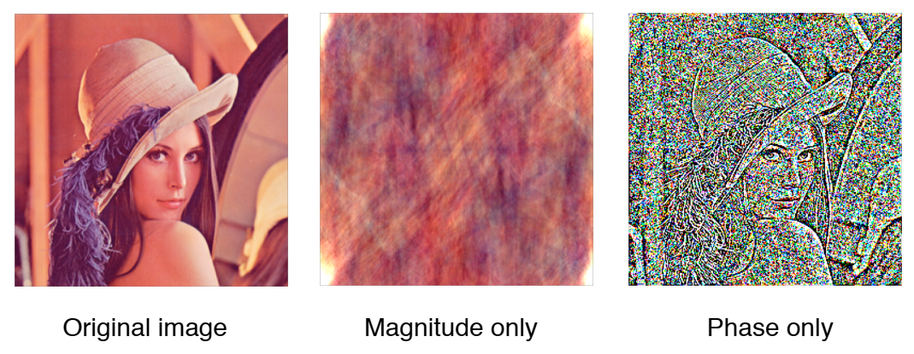

Slide 14
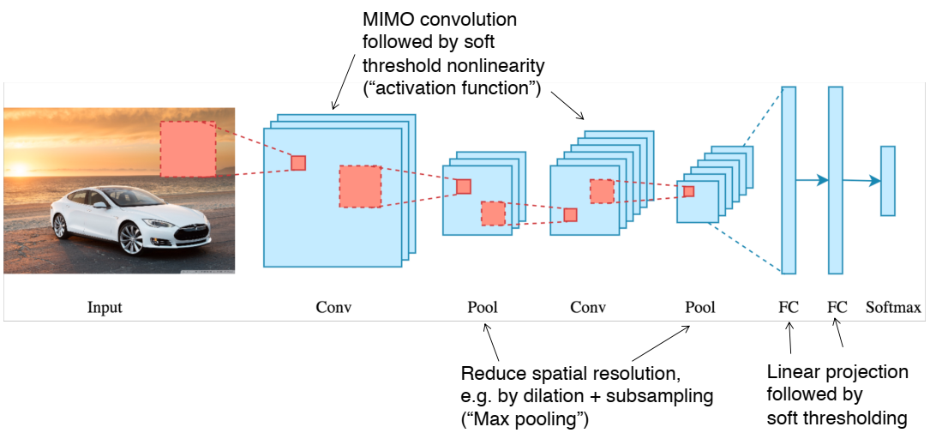
Convolutional Neural Networks

Slide 15
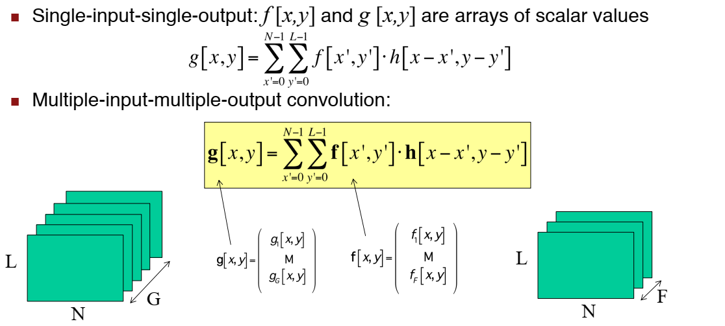
MIMO Convolution

Slide 16
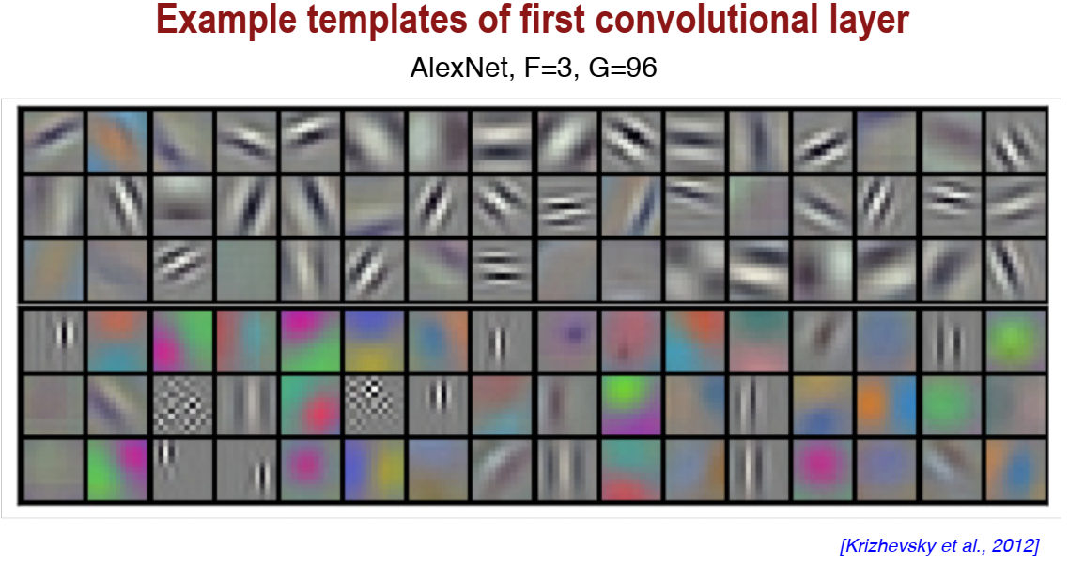

Slide 17
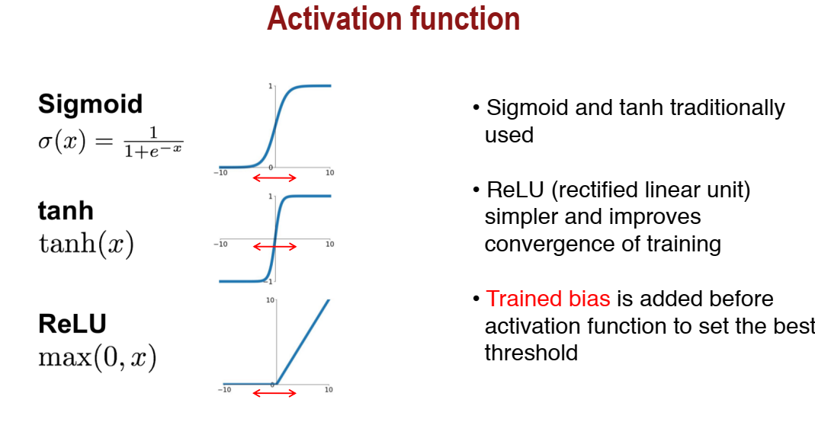

Slide 18
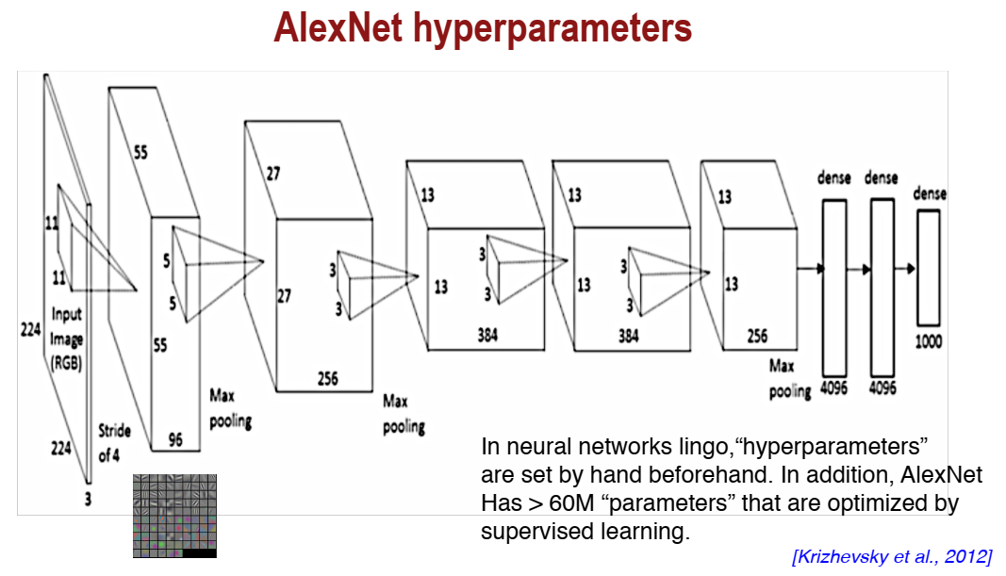

Slide 19
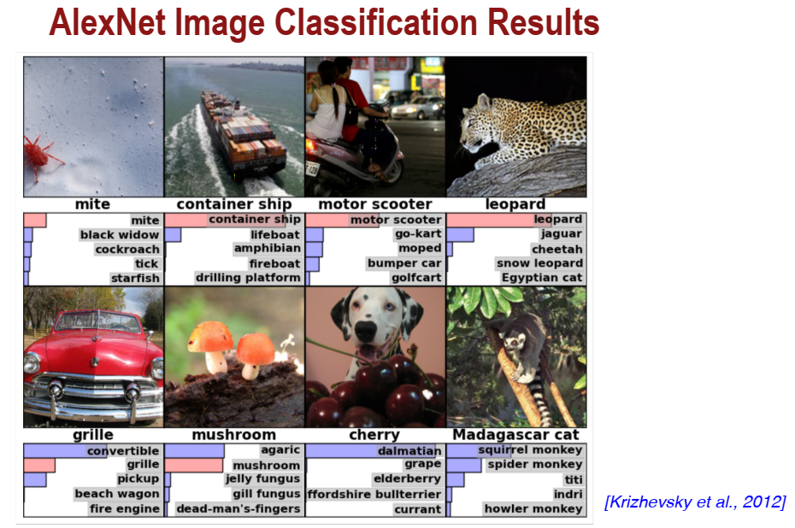

Slide 20
